Slide 1

NBA MVP Prediction Model
Isaac Marr
2025 FAS Technical Challenge

Slide 2
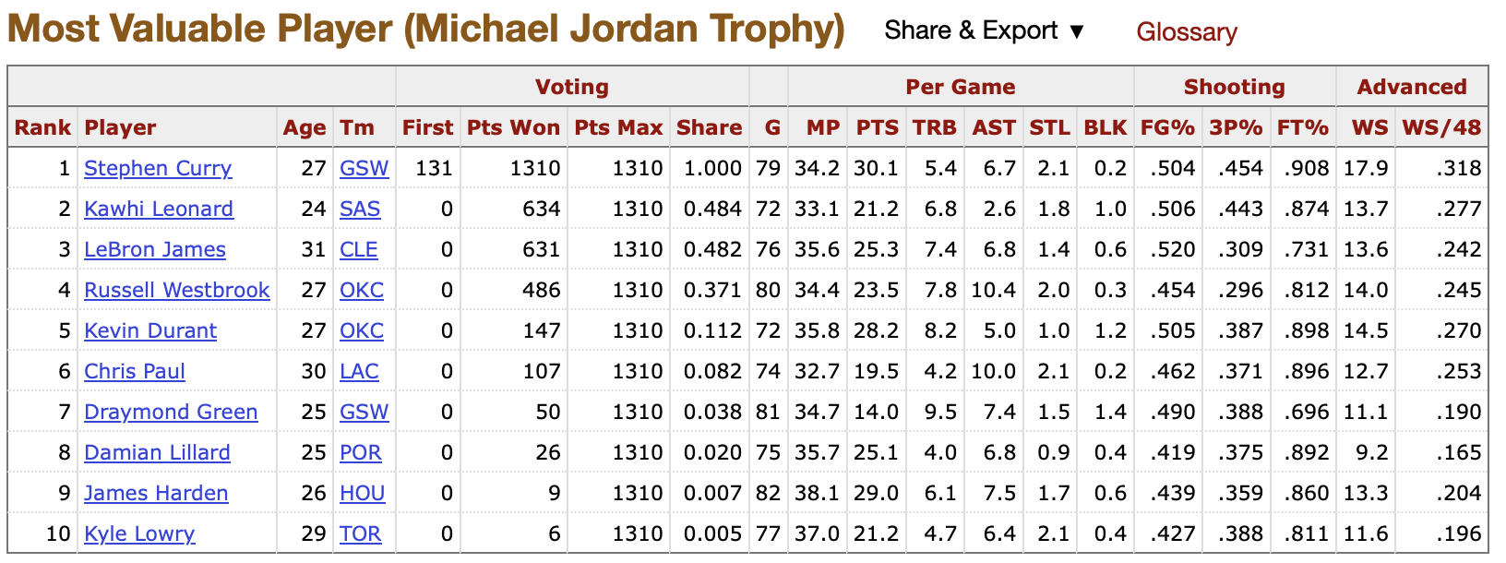
Data Acquisition
Collected both traditional and advanced statistics from the NBA API from the 2000-01 season to the 2024-25 season.
Manually exported MVP voting data from Basketball Reference to use as the response variable. (See an example to the right)
The variable “MVP_SHARE” is the player’s MVP voting points divided by the total possible points. For example, Steph Curry’s 2016 unanimous MVP gave him a value of 1.0.
This provides a more robust set of MVP candidates for my model.
Merged the response variable into the NBA data before cleaning and standardizing.
Saved the data to a csv for reproducibility.

Slide 3
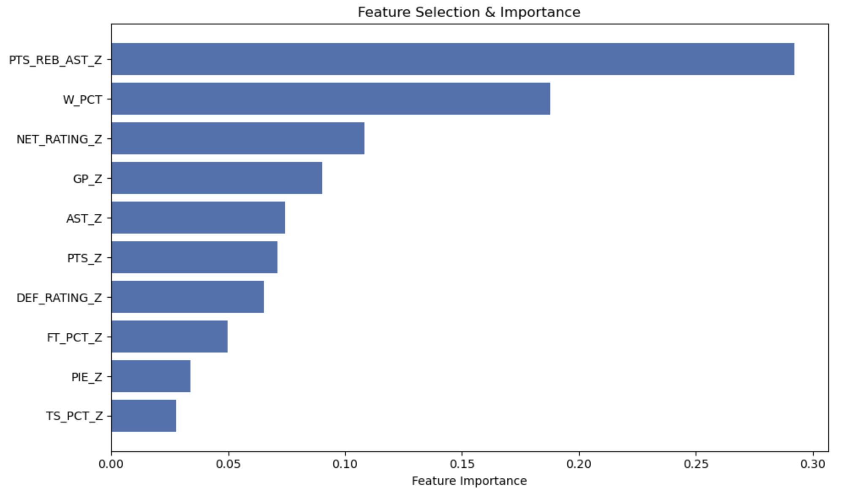
Feature Engineering & Selection
In addition to the NBA API data, I calculated a sum of points, rebounds, and assists to get a better sense of overall player box score impact. I also calculated a Z score for all quantitative features to adjust for era.
I ran a random forest model with all box score, advanced, and Z-score stats. I then selected the features with importance above 1% for my final model. I decided to use Z-scores only and dropped the non-Z score features from my model.
You can see my final list to the right. This selection passes the eye test. Box score stats are very important, as is team win percentage. Free throw shooting and true shooting show that getting to the line and taking efficient shots is weighed heavily. Finally, more advanced stats like Net Rating, Defensive Rating, and PIE provide a good picture of overall player value.

Slide 4
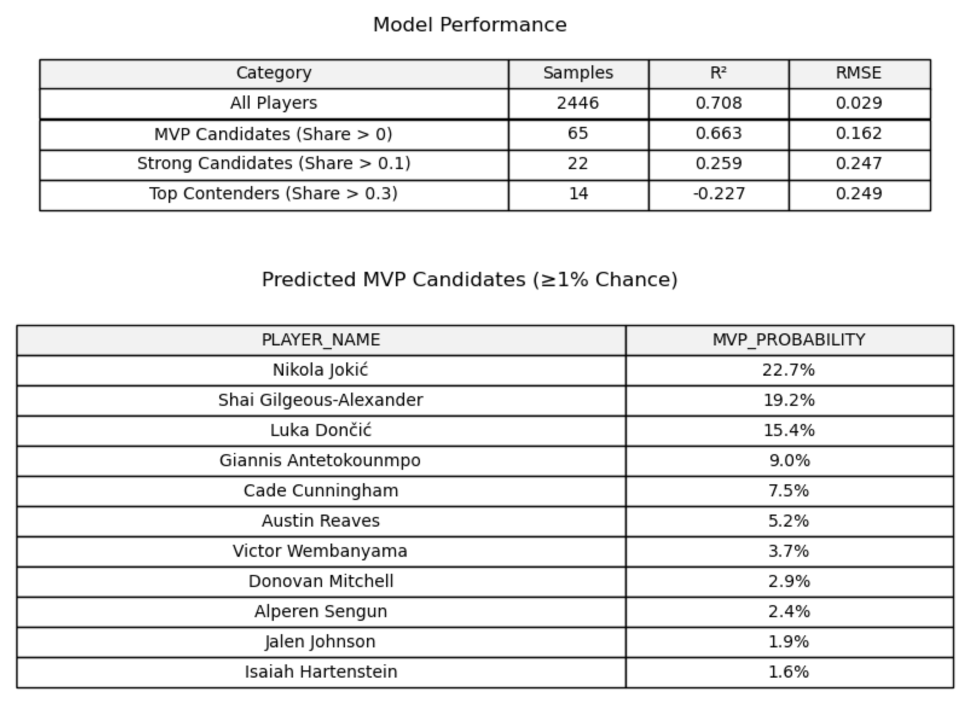
Model Performance & Takeaways
As you can see in top table on the right, the model performs very well in distinguishing non-MVP contenders from players who should receive votes, explaining 66-70% of the variance.
The model starts to falter as it tries to separate the strong contenders from the fringe contenders.
This is due in part to the very small sample size, the model did not train on very many strong contenders at all.
Also, the MVP is partially a narrative award, and the voters may factor in narrative more when choosing between the top 2-3 candidates.
Despite this, the output of the model looks accurate. Jokic, SGA, Luka, and Giannis are true top contenders, while the dark horse candidates are all reasonable.

